Slide 1
Traffic-Sign-Recognition
using a Concept Bottleneck Model
Luka Vracevic, Fabian Aurin, Aaron Ziglowski
16.12.2025

Slide 2
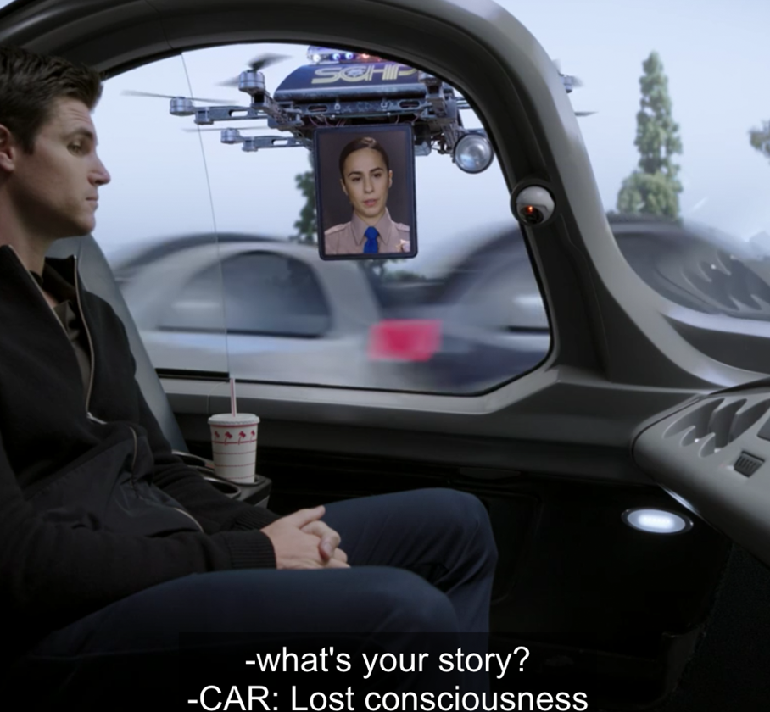
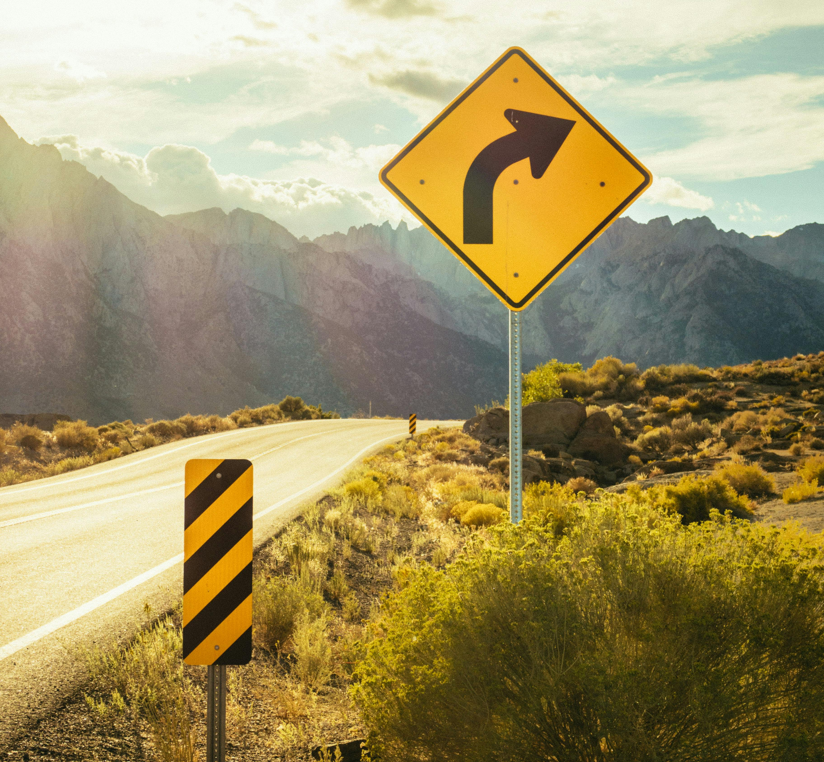
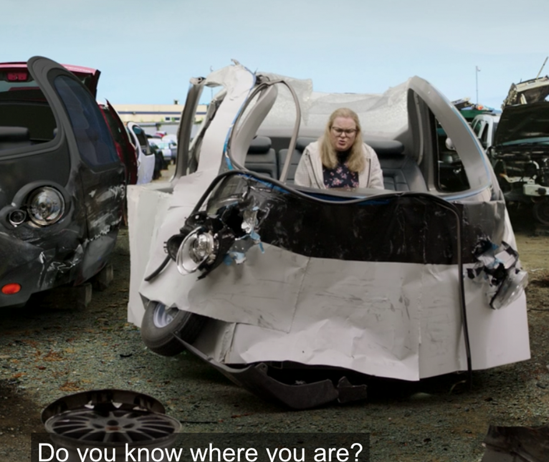
Problem Statement
Intermediate Presentation
?!
Self-driving Car
Road Sign
Not-driving car
Somewhere in the near future
As per usual
The bad ending

Slide 3
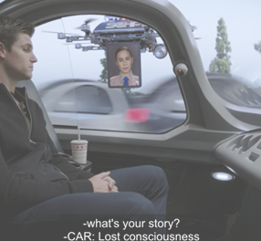
Problem Statement
Intermediate Presentation
CBM
Self-driving Car
Road Sign
Still-driving car
Somewhere in the near future
As per usual
The good ending

Slide 4
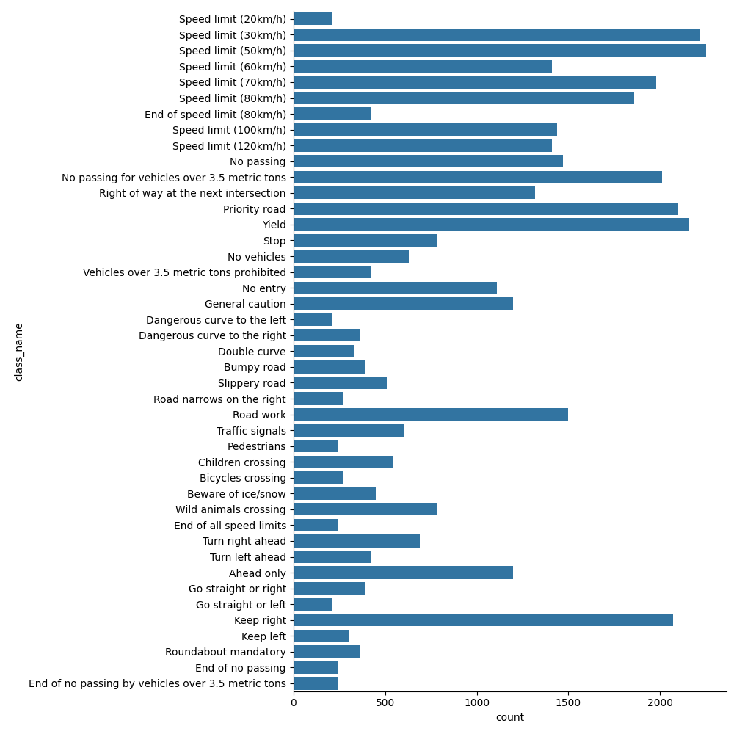
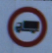

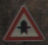
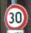

EDA Results
Class distribution & Samples
Note that:
Class frequency varies greatly
Intuitively similar signs are present in very different quantities (e.g. Keep right vs Keep left)
Image size & lighting differs
16.12.2025

Slide 5
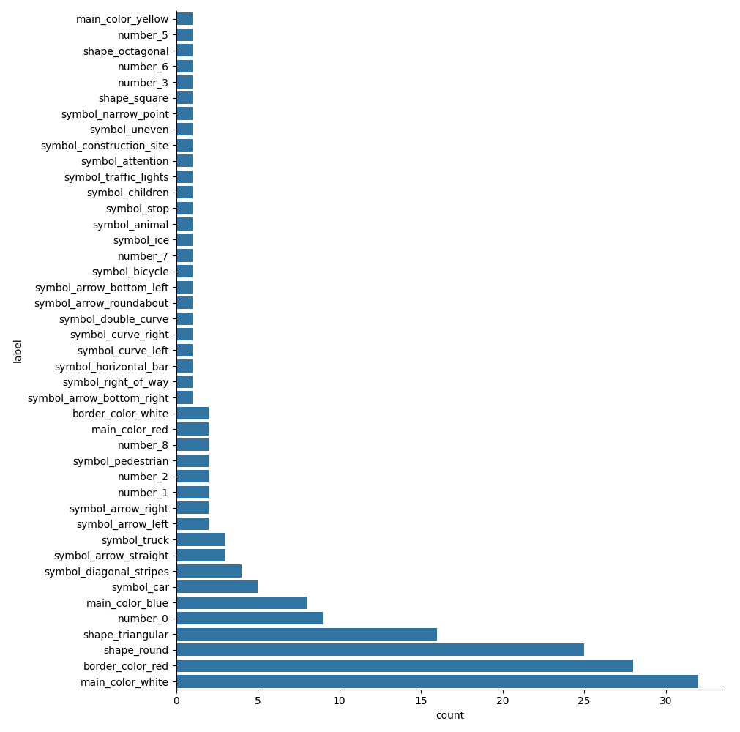
EDA Results
Concept distribution
Note that:
Only a small subset of concepts is present in more than 5 signs
26 concepts are present exactly once
80% of all concepts are present at most twice
This may cause high concepts → signs accuracy for classes possessing unique features
16.12.2025

Slide 6
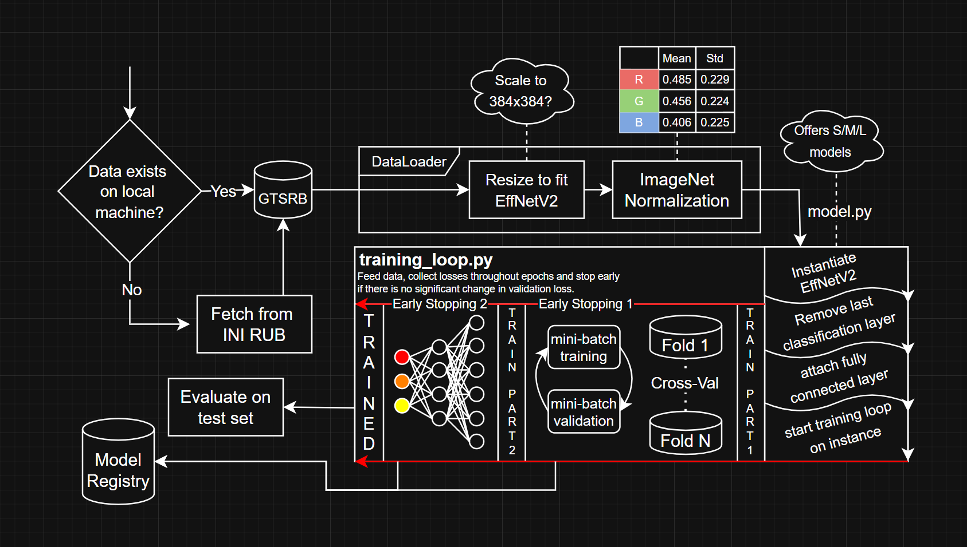
Pipeline Architecture (WIP)
Intermediate Presentation

Slide 7
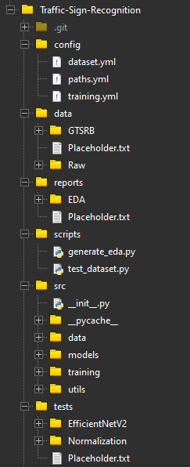
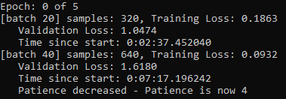

Status Quo
Intermediate Presentation
No experiments yet because we did not create a suitable environment yet and with the current setup:
Mid-epoch early stopping by checking every x batches because of dataset size
There are ~2000 batches per Epoch (bsize: 16)
There are at most 5 Epochs (early stopping)
There are 5 folds (design choice)
Training & validating 20 batches in ~ 3min ()
$$\frac{2000}{20}∙5∙5∙3min=7500min\hat{=}125h max$$

Slide 8
Bildquellen
Intermediate Presentation
https://www.jalopnik.com/jalopnik/images/xaep1mjulbizalswddfg.jpg
https://images.pexels.com/photos/2994331/pexels-photo-2994331.jpeg?cs=srgb&dl=pexels-athena-2994331.jpg&fm=jpg
https://www.jalopnik.com/jalopnik/images/etvtn2zentybmnb0sxlf.jpg

Slide 9
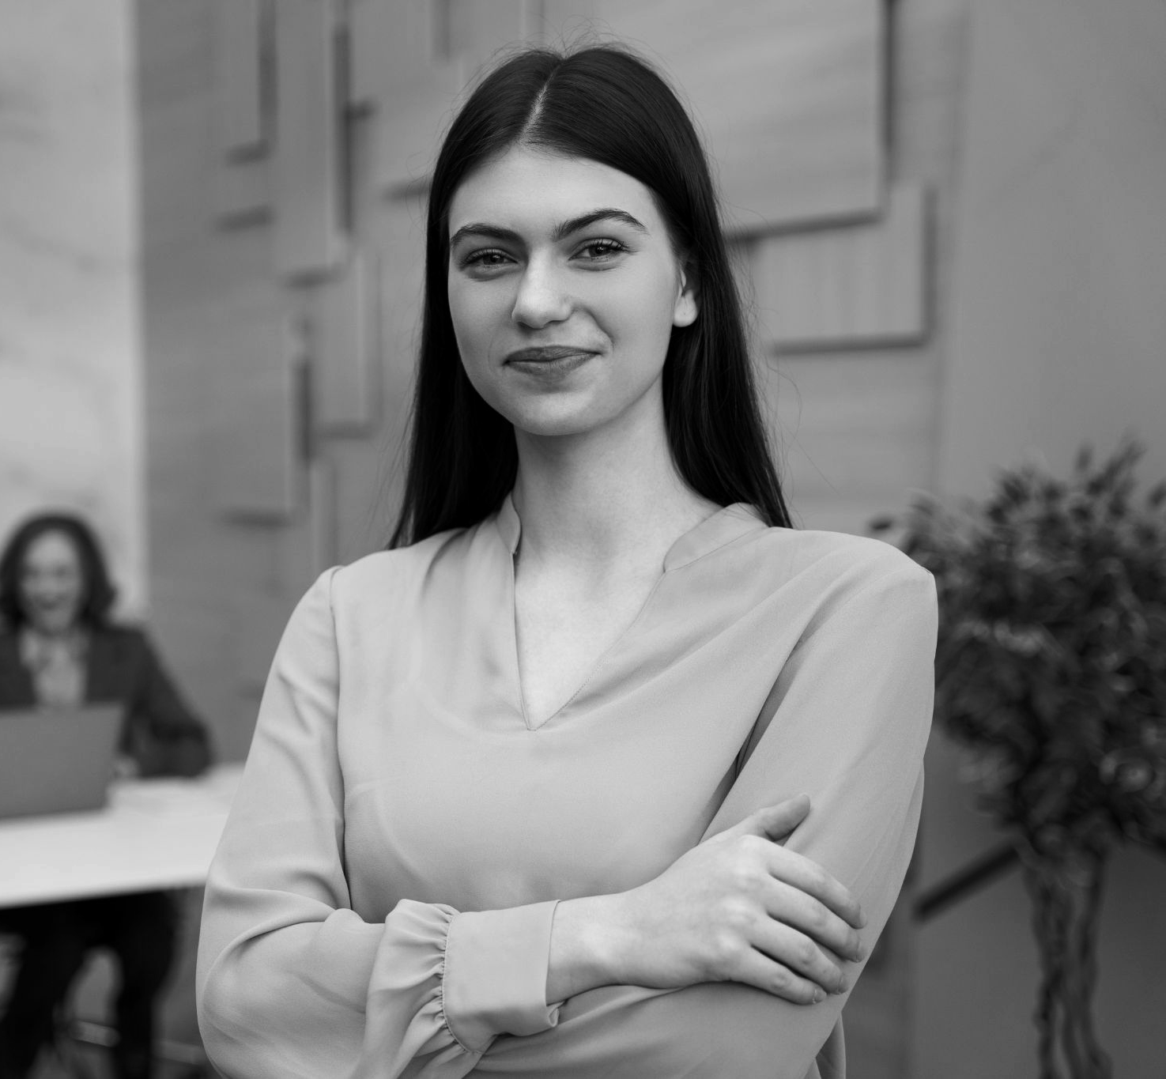
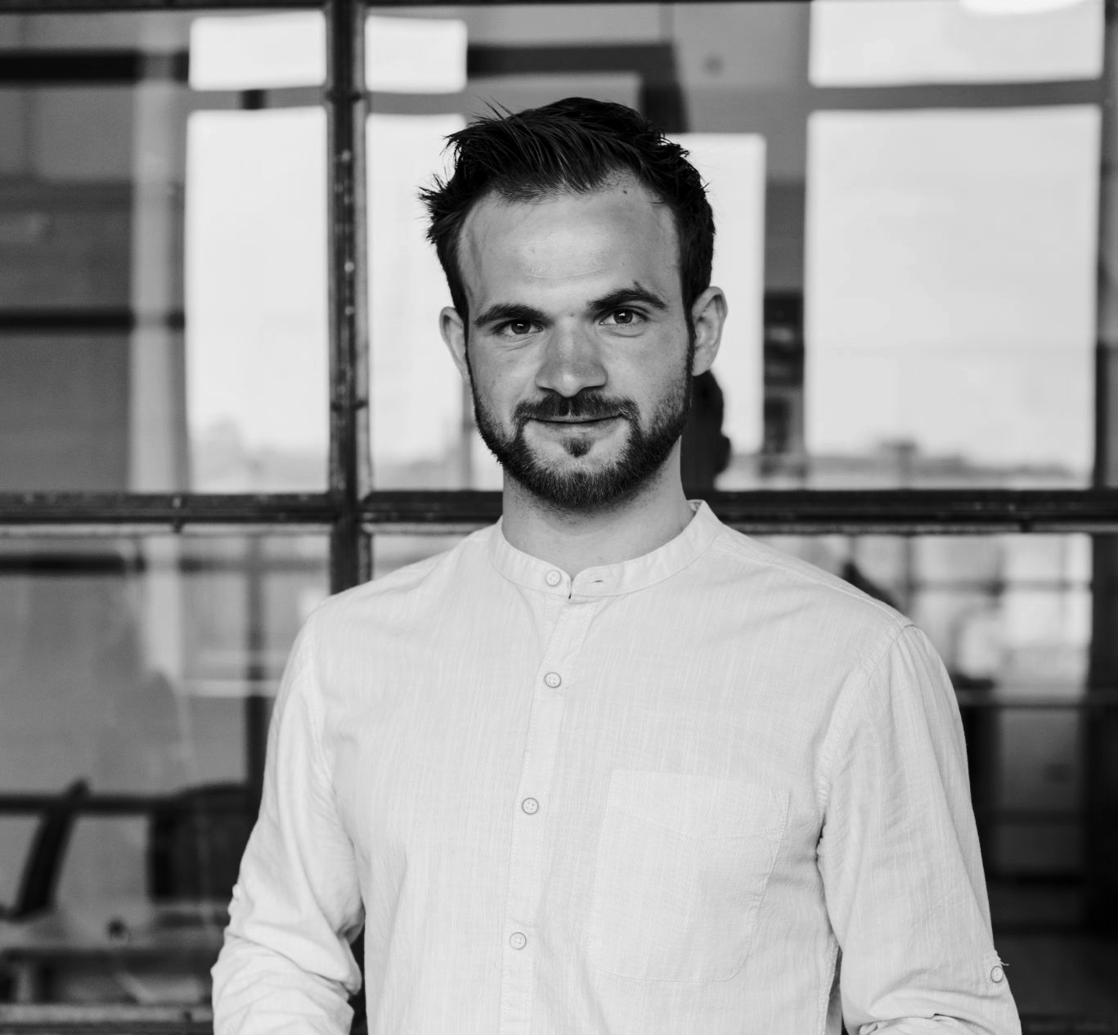
Schedule - session talks
Day 1
Day 2
Day 3
30/06/2022
31/06/2022
01/07/2022
Jenna Doe
Management techniques
CEO & Founder
Saturn is a gas giant and has several rings. It's composed mostly of hydrogen and helium. It was named after the Roman god
9:00 - 11:00 am
Day 1 - Mars Theatre
Timmy Jim
Build your OWN business
Accountant Manager
Jupiter is a gas giant and the biggest planet in the Solar System. It's the fourth-brightest object in the night sky
11:15 - 15:15 pm Day 2 - Mars Theatre
Schedule

Slide 10
Timeline
Timeline
Jupiter is the biggest planet of them all
Despite being red, Mars is very cold
Neptune is the farthest planet
Jupiter
Mars
Neptune
01
02
03
04
05
Saturn
Venus
Saturn is a gas giant with several rings
Venus is the second planet from the Sun

Slide 11
02
Our idea
Our time
You can enter a subtitle here if you need it

Slide 12
Our big idea #1
Mercury
Venus
Mars
Mercury is the closest planet to the Sun
Venus is the second planet from the Sun
Mars is actually a very cold place
Jupiter
Saturn
Neptune
Jupiter is the biggest planet of them all
Saturn is composed of hydrogen and helium
Neptune is the farthest planet from the Sun
Our big idea #1

Slide 13
9h 55m 23s
333,000
386,000 km
Jupiter's rotation period
The Sun’s mass compared to Earth’s
Distance between Earth and the Moon
Big numbers

Slide 14
Pricing
$100
$300
$500
Pricing
Basic
Medium
Pro
You can write the characteristics here
You can write the characteristics here
You can write the characteristics here
You can write the characteristics here
You can write the characteristics here
You can write the characteristics here

Slide 15
What’s next
Jupiter is the biggest planet
Despite being red, Mars is very cold
Neptune is the farthest planet
Saturn is a gas giant with several rings
Jupiter
Mars
Neptune
Saturn
Then
Now
Jupiter is the biggest planet of them all
Saturn is composed of hydrogen and helium
What’s next

